Slide 1
Matthew Curtner-Smith, February 14th, 2022
THE SPECTRUM AS FOUNDATIONAL OR INTEGRATED WITH MODELS-BASED PETE?

Slide 2
A Little bit about me . . .

Slide 3
English!!!!

Slide 4
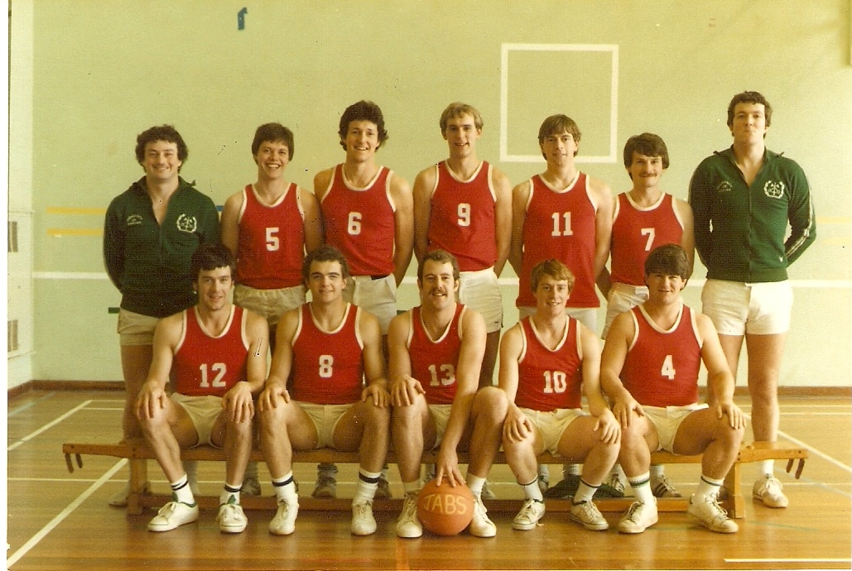
Training
Trained to teach physical education and history at the University of Exeter, UK

Slide 5
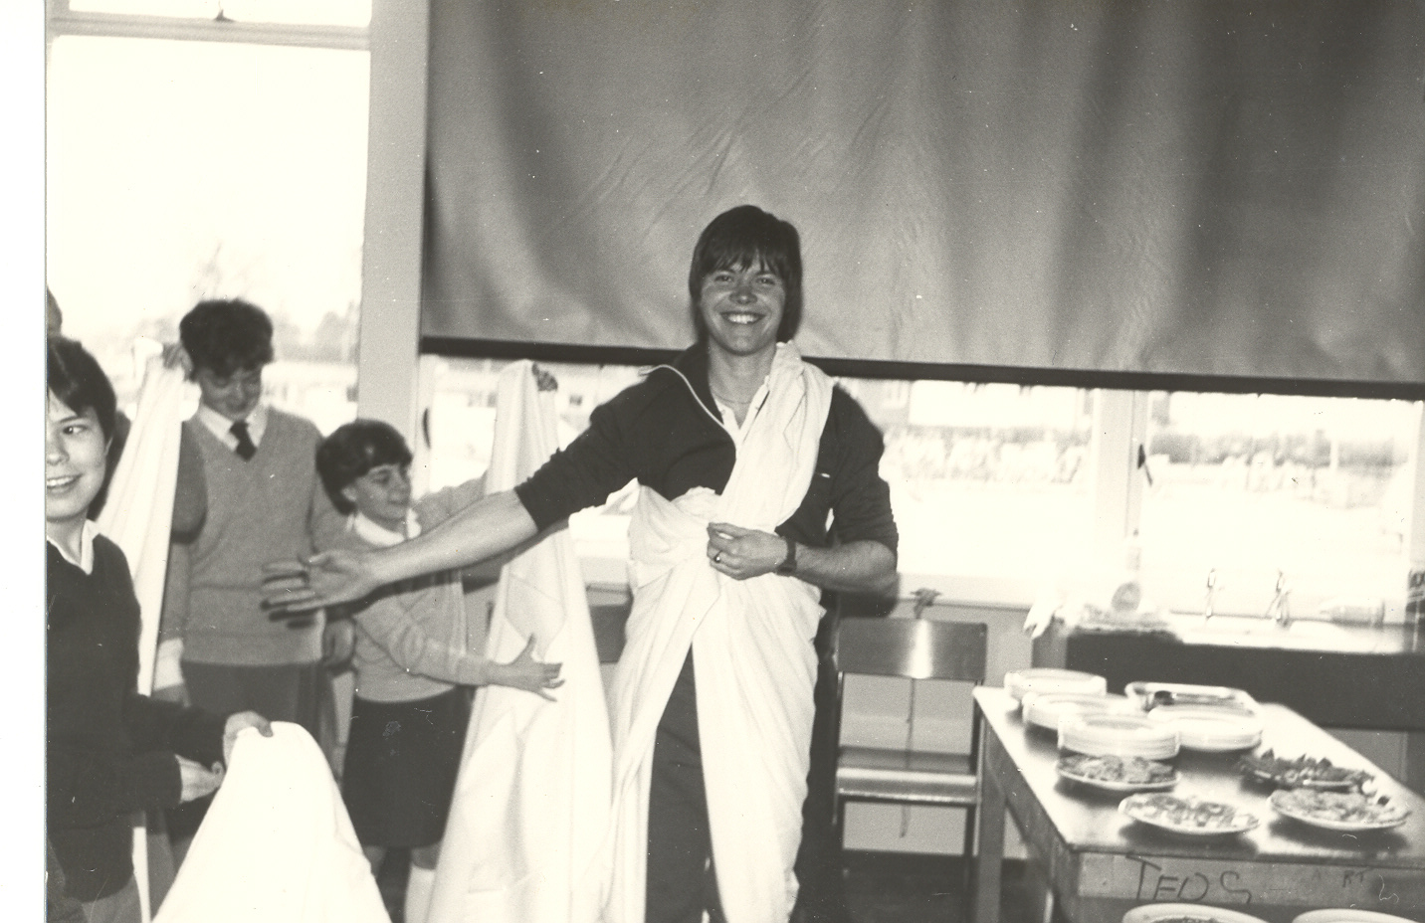
Teacher
Taught at a secondary school in the UK

Slide 6
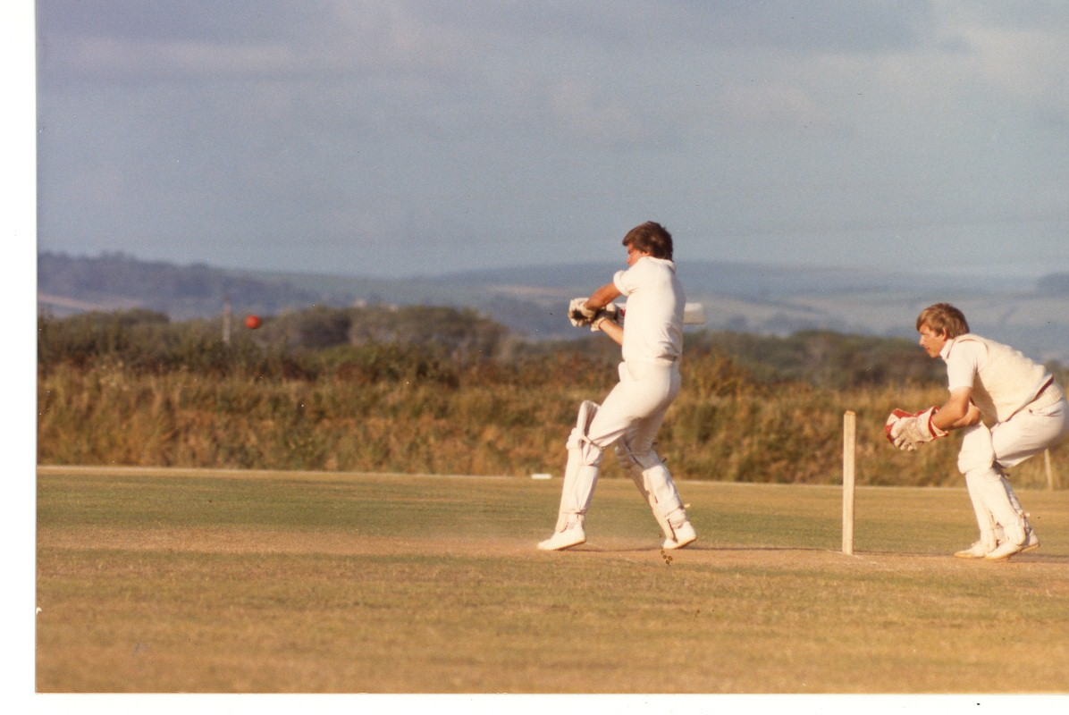
Cricketer

Slide 7
Runner . . .

Slide 8
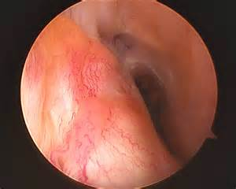
Until knee surgery

Slide 9
Biker . . .

Slide 10
Until clavicle surgery

Slide 11
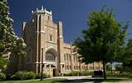
Graduate work
Completed my master’s degree and doctorate in sport pedagogy at Colorado State University and the University of Northern Colorado.

Slide 12
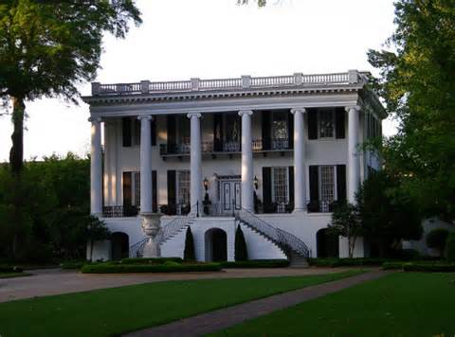
UA
In my 31st year doing PETE at The University of Alabama with a big focus on the Spectrum.

Slide 13
Purpose
To generate discussion about how we use the Spectrum within modern PETE.

Slide 14
Question 1
How to conceptualize the Spectrum within modern PETE?

Slide 15
Question 2
How to teach the Spectrum within modern PETE?

Slide 16
Ideas about conceptualizing and teaching the Spectrum within Modern PETE (1)
The Spectrum is a set of foundational micro-pedagogies.
It is taught in isolation:
After PTs learn other foundational micro-pedagogies from the effectiveness research--Direct Instruction(see Silverman, 1991).
Prior to models-based PETE (macro-pedagogies).

Slide 17
Ideas about conceptualizing and teaching the Spectrum within Modern PETE (2)
The Spectrum is integrated with models-based PETE.
It is taught:
After PTs have learned micro-pedagogies from the effectiveness research.
Within courses on various curriculum models.
For example, the multi-activity model, sport education, TPSR, TGfU, the skill themes approach, health-related fitness.

Slide 18
Ideas about conceptualizing and teaching the Spectrum within Modern PETE (3)
The Spectrum is a model itself.
It is taught:
After PTs have learned micro-pedagogies from the effectiveness research.
During a dedicated course.

Slide 19
Questions for you
How do you conceptualize the Spectrum within modern PETE?
How do you teach the Spectrum in your PETE?
Do you view the Spectrum as a set of foundational micro-pedagogies?
Do you view the Spectrum as being integrated with curriculum models?
Do you view the Spectrum as a curriculum model (macro-pedagogy)?

Slide 20
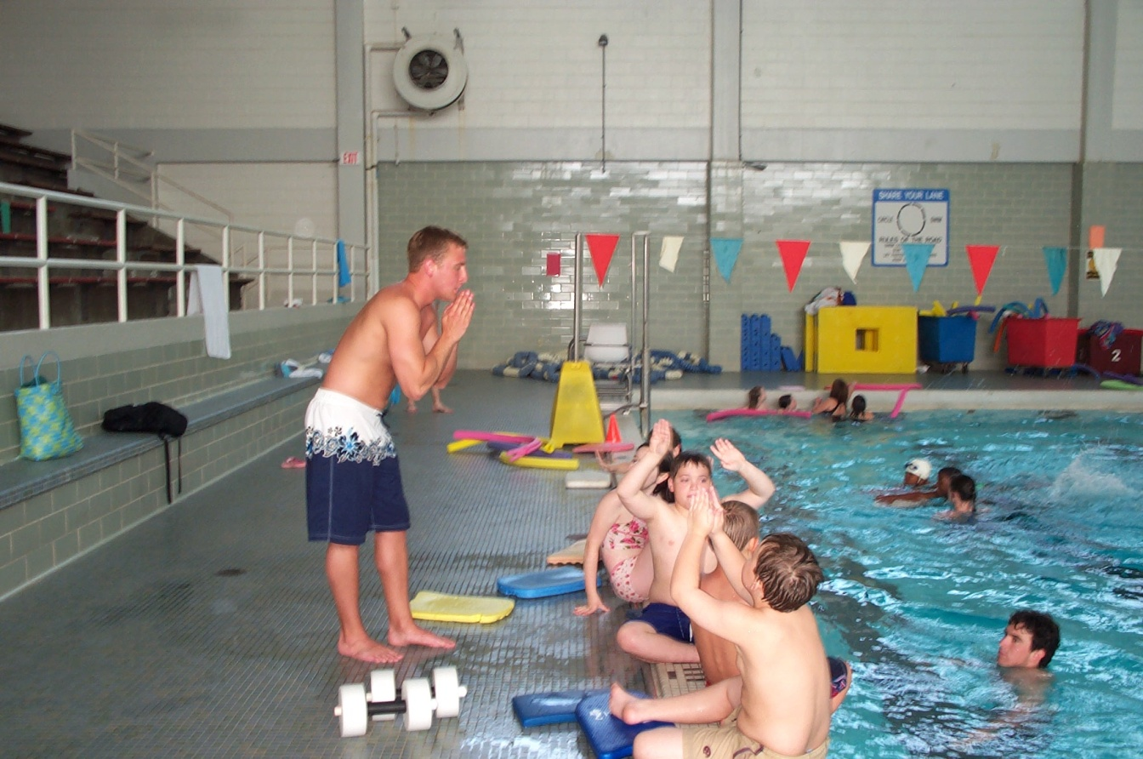
Thanks for listening to and indulging me!

